Slide 1
Welcome to our presentation!
Team Peacekeepers
Dhaka,Bangladesh
Md Mehedi Hasan
Fariha Tahosin Boishakhi
Muhammad Mustaqim
Ponkoj Chandra Shill

Slide 2
Gray To Green

Slide 3
Gray To Green
SEARCH

Slide 4
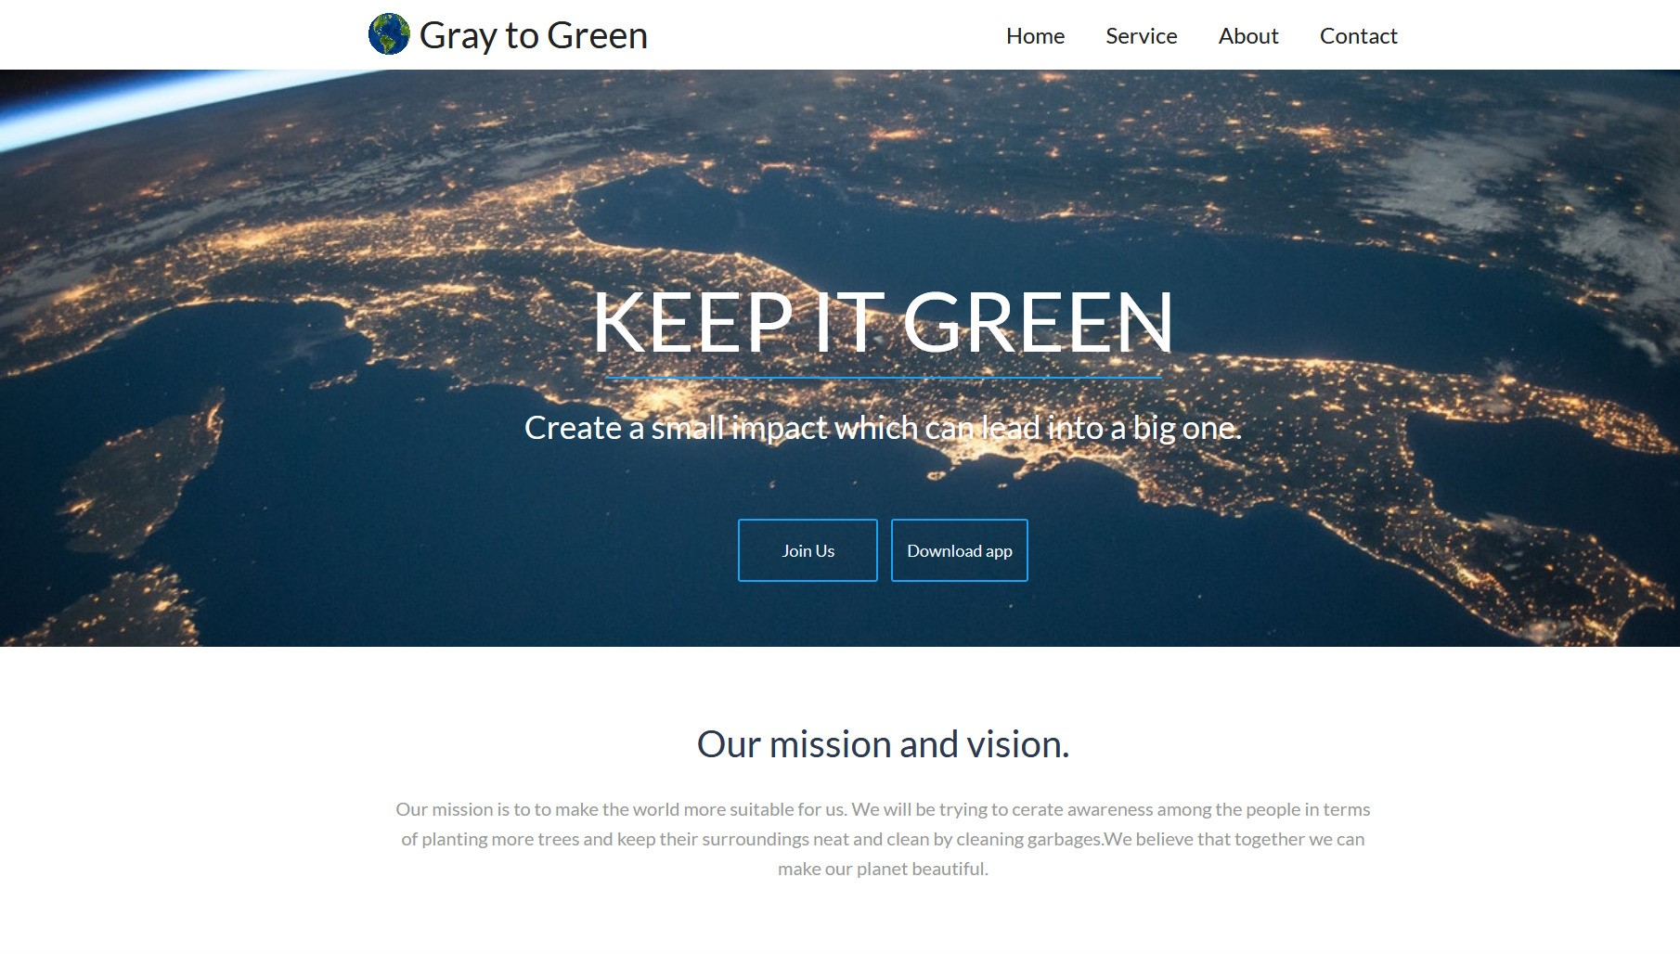

Slide 5
Contents
1
Introduction & Our Idea
2
Why It is unique
3
How does it work
4
Impact & Needs
5
Data set information

Slide 6
Introduction
Our idea is to build an app that can solve the lower number of trees in specific areas and wastage or garbage problem in our surroundings.
Category: Living in our world
Sub-category: Smash the SDG[SDG 13, Climate change]

Slide 7
Why it is unique
Connects to people
Providing Useful data to everyone
Inspire people to make small changes
Create social awareness
Small impact leads to the bigger picture

Slide 8
How does it work
Provide ratio between human & trees
Used image processing approach to detect trees
Locate nearby garbage heap
Providing opportunity to learn space stuffs

Slide 9
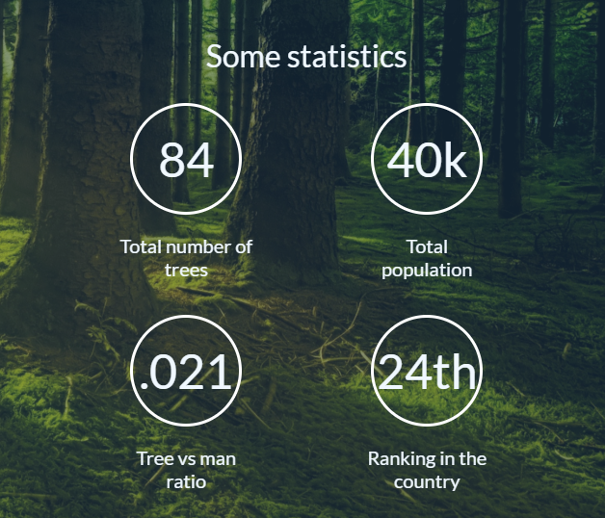
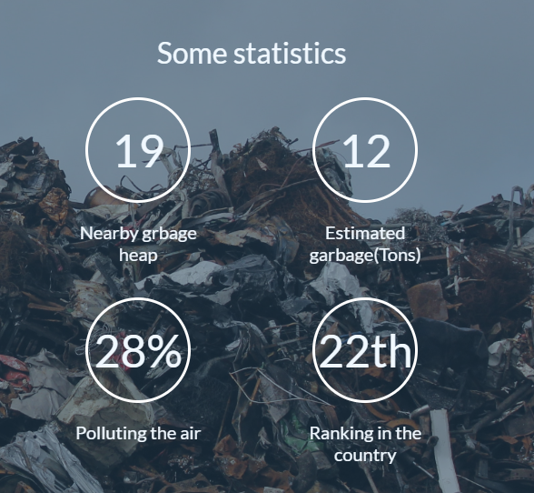
Impacts & Needs
Aims to make the society a better place to live
Encourage people for planting more trees
Inspire people to keep the society clean
Ensuring healthy future for the next generation

Slide 10
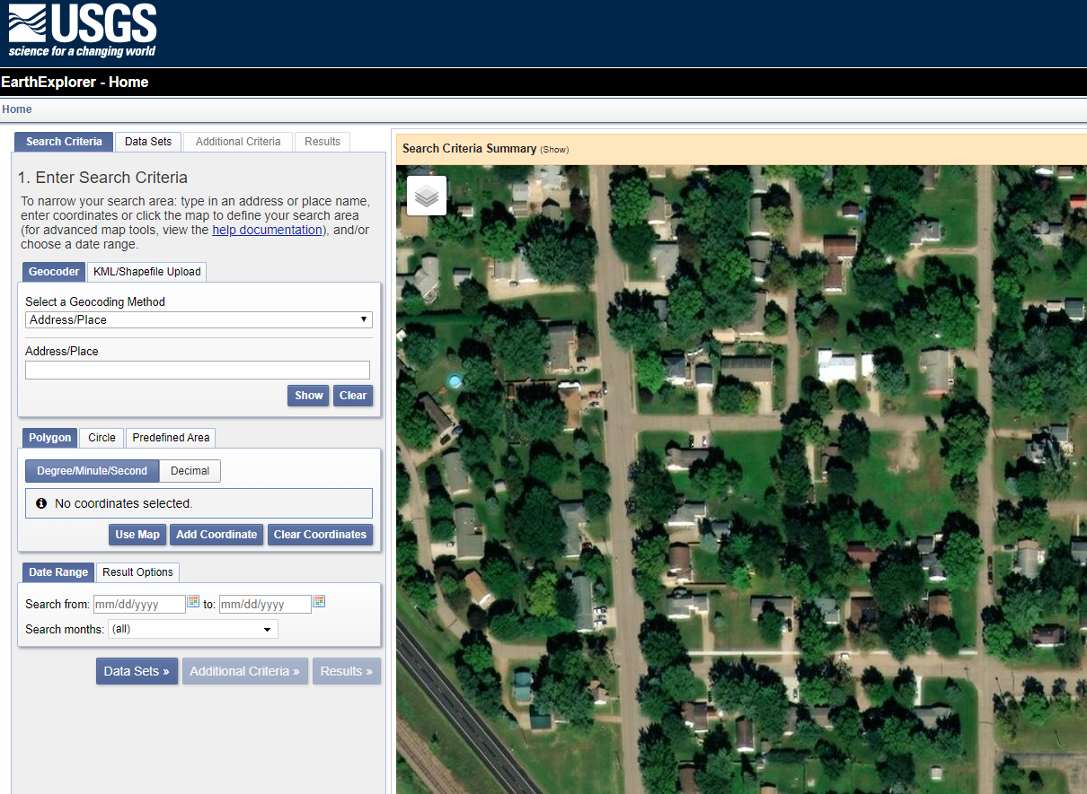
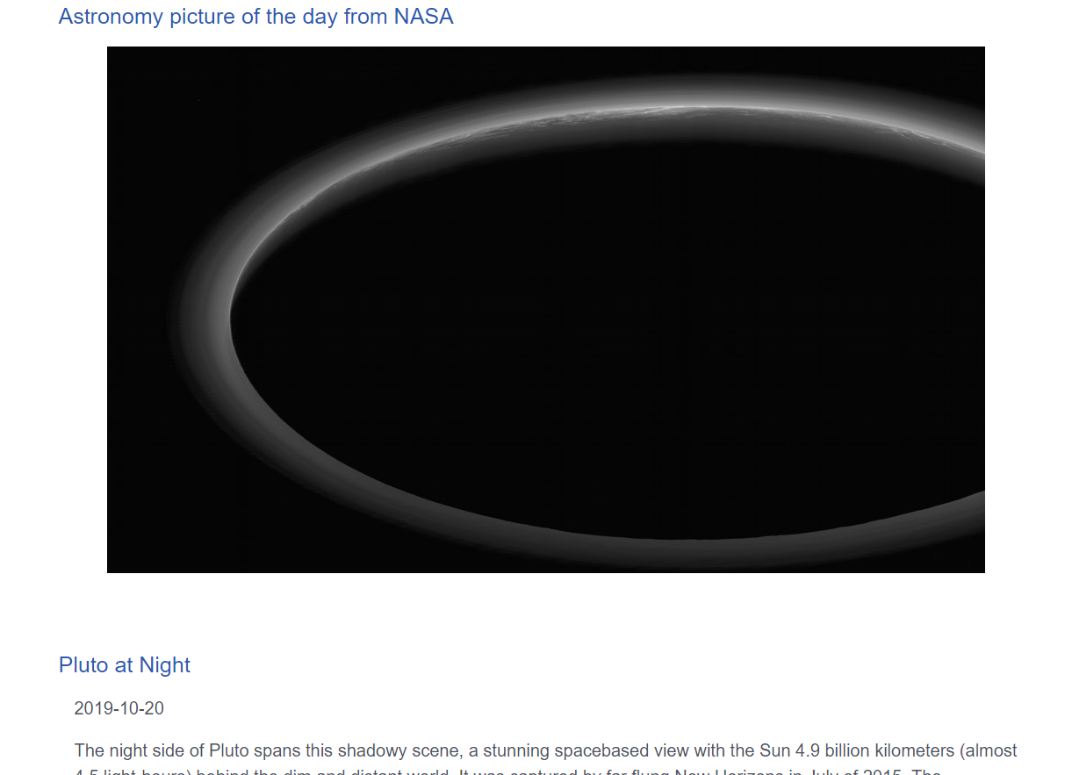
Data set & API
NASA USGS data for satellite image
NASA USGS data for map view
NASA APOD API for space stuffs

Slide 11
Thank you

